Slide 1
Depth-First Search
By Matthew Conover

Slide 2
Traversing a graph
Graphs are one of the more complex data structures to traverse.
Every graph can be radically different
There are two main types of traversals for graphs
Breadth-First Search
Depth-First Search
I will be covering the former: Depth-First Search

Slide 3
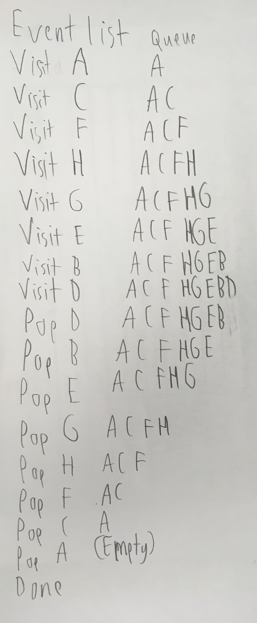
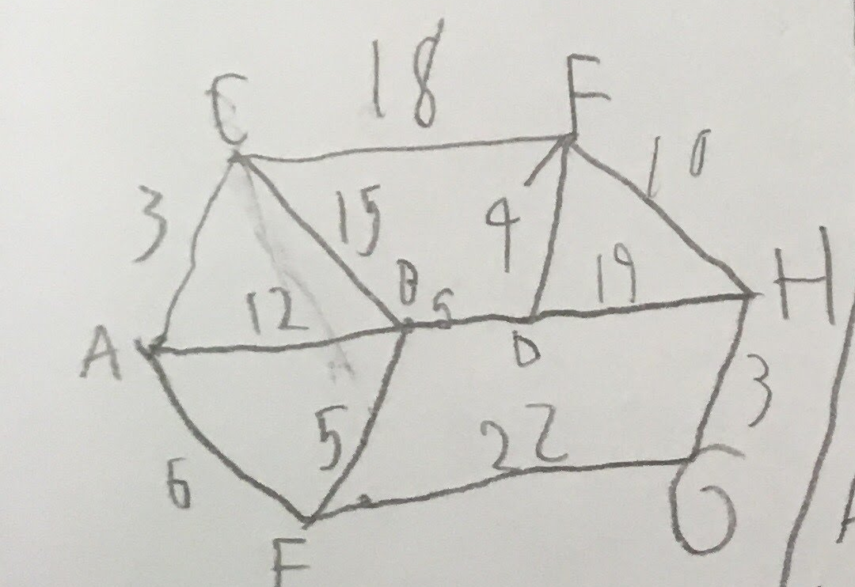
The rules of DFS
0: Put any vertex to start with. Visit it, mark it, and push its label onto the stack
1: If possible, visit an unvisited adjacent vertex, mark it, and push its label onto a stack.
2: If 1 is impossible, then pop a vertex off the stack, if possible.
3: If 1 and 2 are impossible, you are done.

Slide 4
Changes made for the DFS algorithm
Graph changes
Added a stack variable
Modified addVertex, addEdge, and displayEdges methods to use the new Vertex Variables.
New reset method
The DFS method/algorithm
Vertex changes
Added int edges, int location, and Vertex array adjacencyList[] variables with getters and setters for each.
New addEdge, setVisited, resetVisited, and getAdjacencyListLocation methods.
Modified List print method

Slide 5
My DFS algorithm steps.
Takes an int for the purpose of deciding which Vertex it will use and returns a string for the result.
Checks if the entry is valid: If not, it will return a message, depending on if it’s an invalid number, or the vertex has no edges.
If number is valid, the algorithm starts with that vertex
It then pushes the vertex onto the stack, then prints it
Checks if vertices in a given vertex’s adjacency list have been visited yet.
If not, the DFS restarts using it as new starting point (Recursive algorithm).
Once Done, it pops the current vertex off the stack and prints new stack
Checks for unvisited vertices and lists them or says none if all were visited.

Slide 6
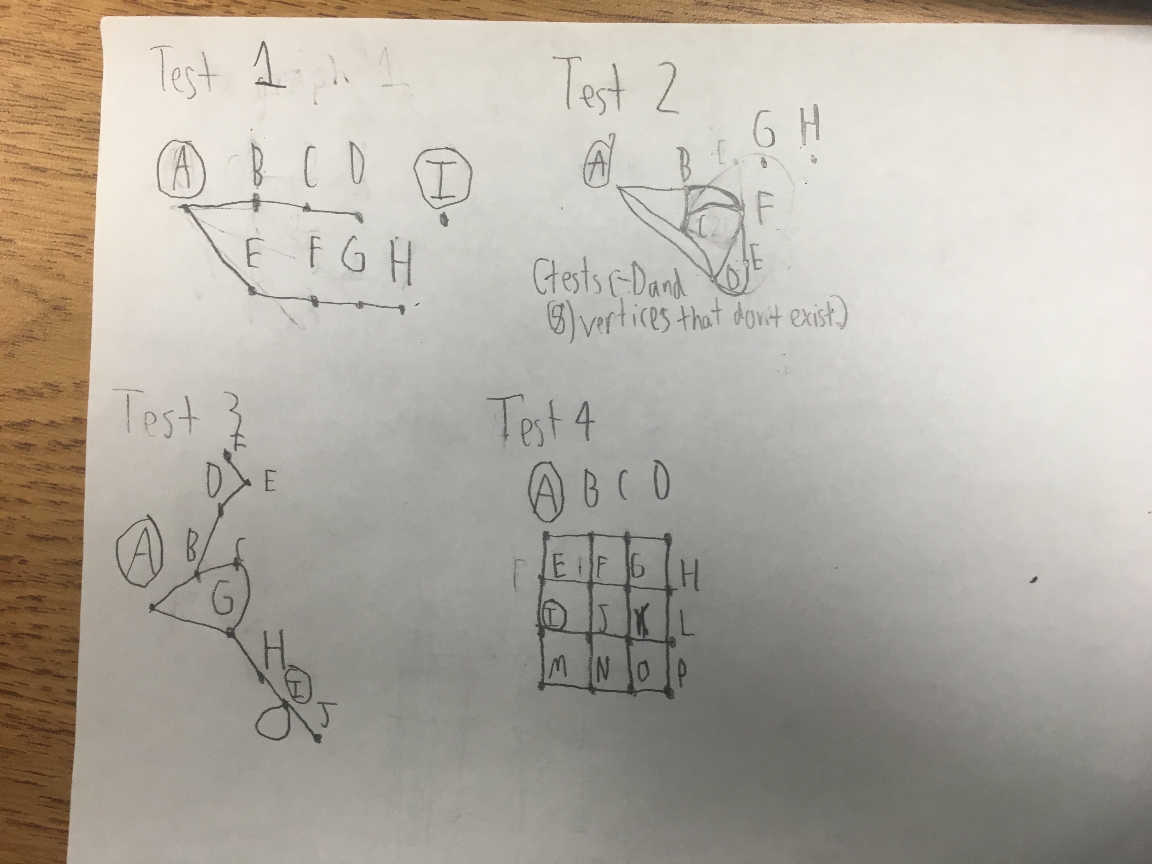
Drawings of the graphs being tested

